Slide 1

STATISTICAL ANALYSIS ON SALES DATA
By SHAZIYA BANU S

Slide 2
STATISTICAL ANALYSIS OF SALES DATA
based on product category
Based on sales of different year.
Based on different product names

Slide 3
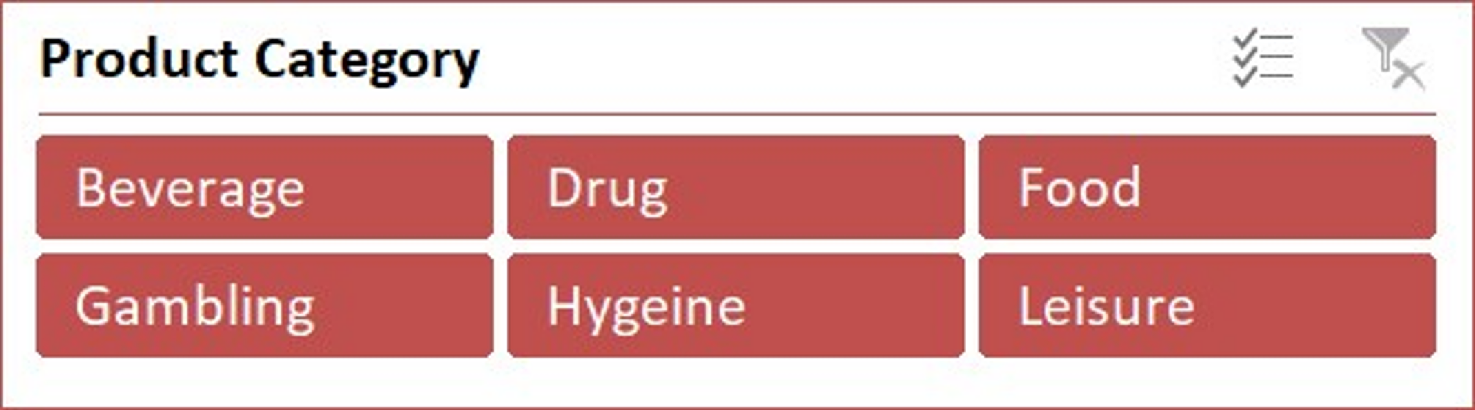
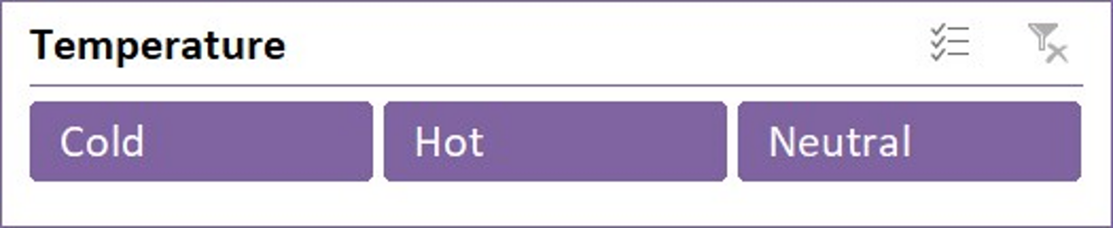
Sales data of a company is taken.
The sales of a company is analyzed in terms of different factors. Interactive dashboard is built and its sales data is obtained with the help of slicers.
They are:
PRODUCT CATEGORIES:
Beverage
Food
Drug
Gambling
Hygiene
Leisure
TEMPERATURE
Cold
Hot
Neutral

Slide 4
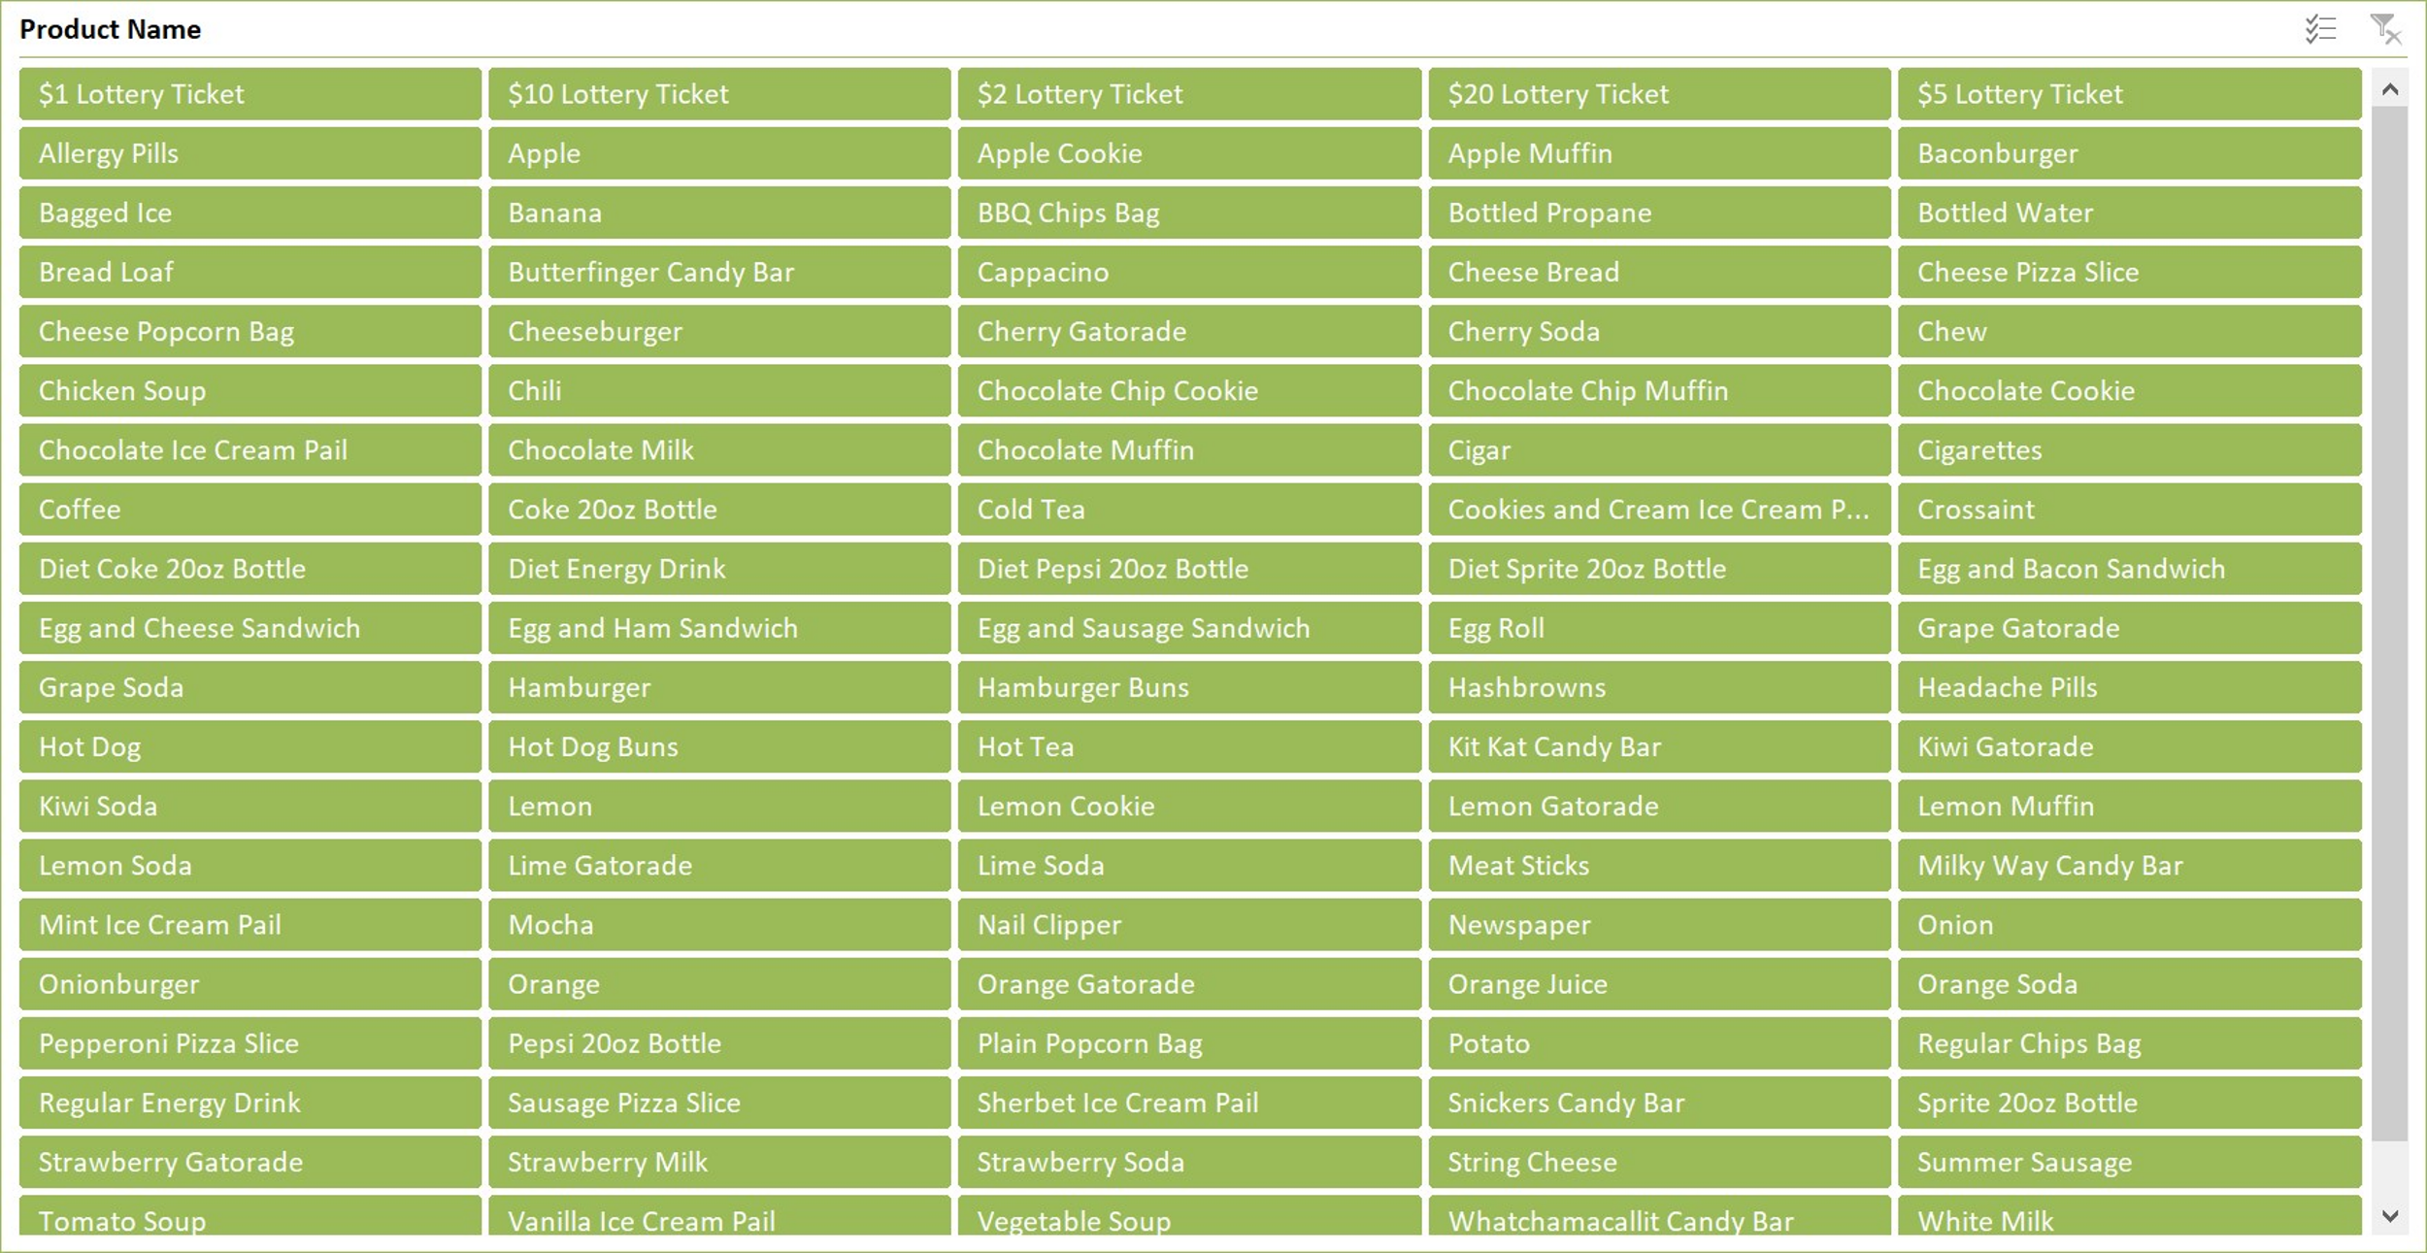
Product names are:

Slide 5
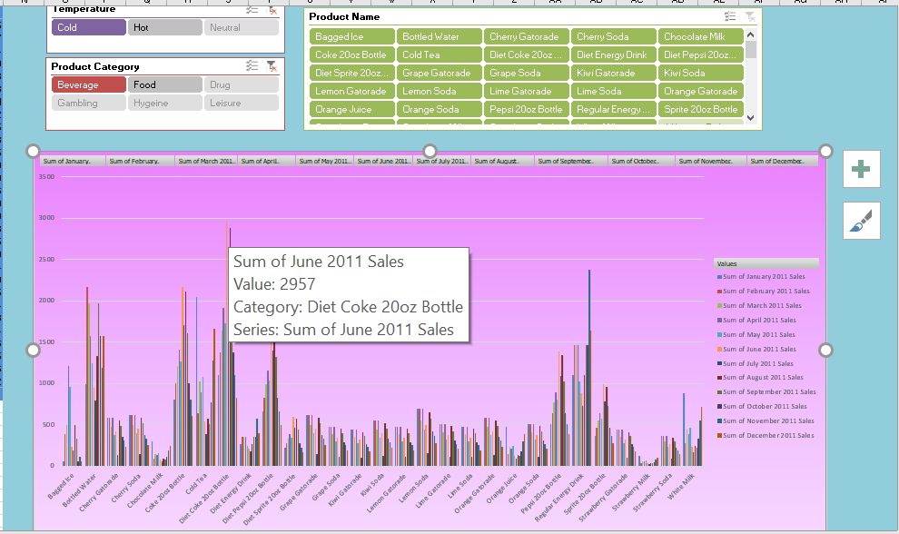
Year 2011
The highest sale in the beverage category and cold temperature is in June 2011 the product is Diet coke 20oz Bottle.

Slide 6
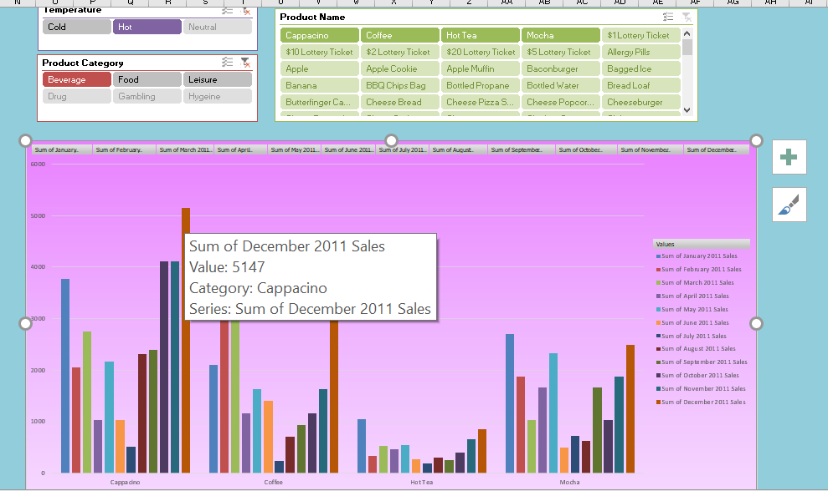
The highest sale in hot beverage category is in December 2011and product name is Cappaccino

Slide 7
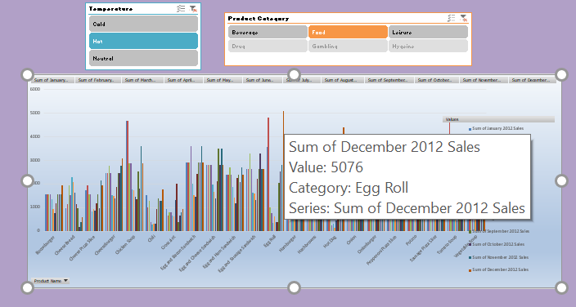
Year 2012
The highest sales in Food category and hot temperature is in December 2012 and the product name is Egg roll.

Slide 8
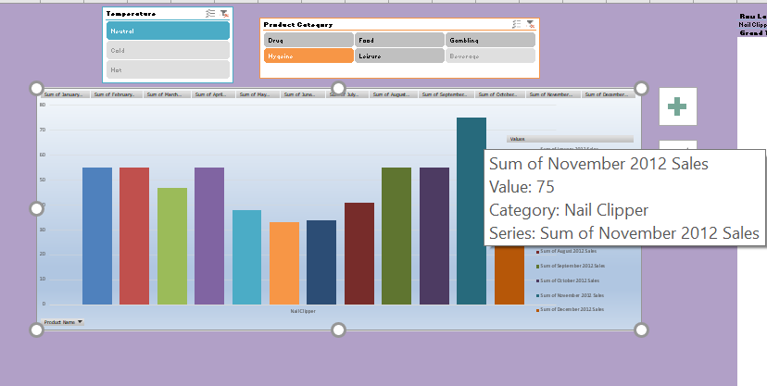
The highest sale in Hygiene category and temperature neutral is in November 2012 and its category nail clipper

Slide 9
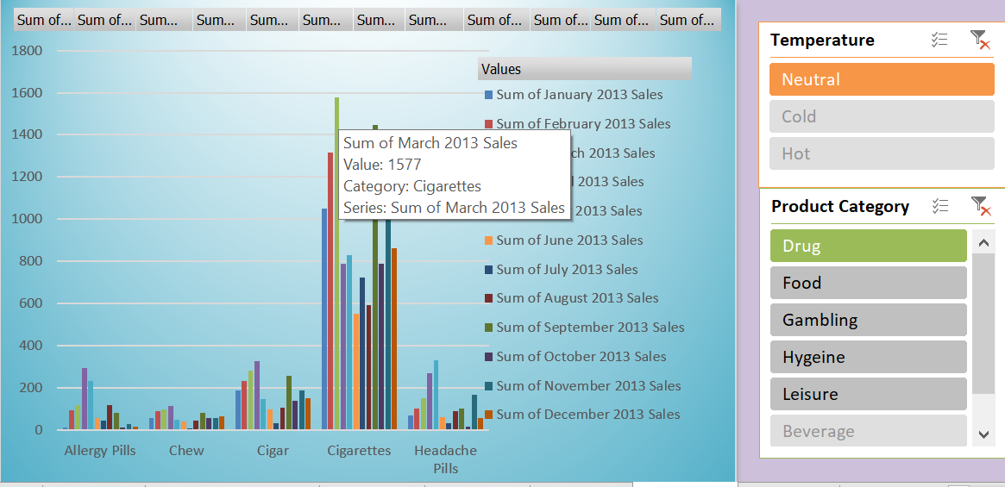
Year 2013
The highest sale in the Drug category and neutral temperature is in march 2013 and the product name is cigarettes.

Slide 10
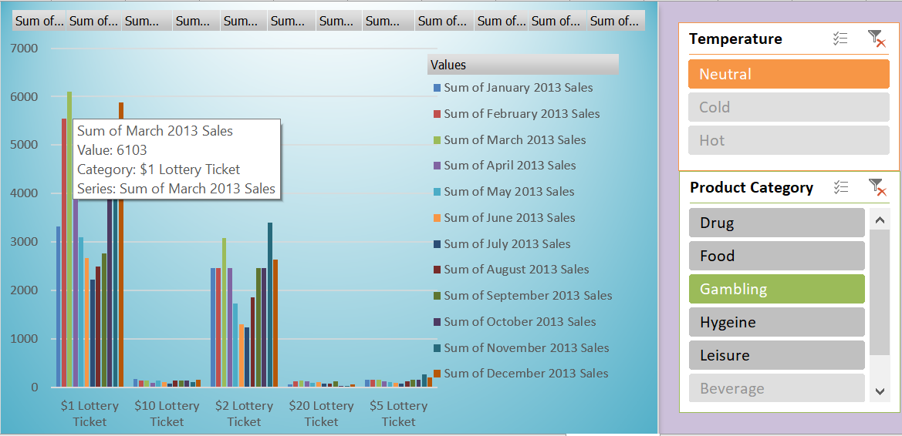
The highest sale in Gambling category with neutral temperature is in march 2013 and the product name is $1 Lottery ticket.

Slide 11
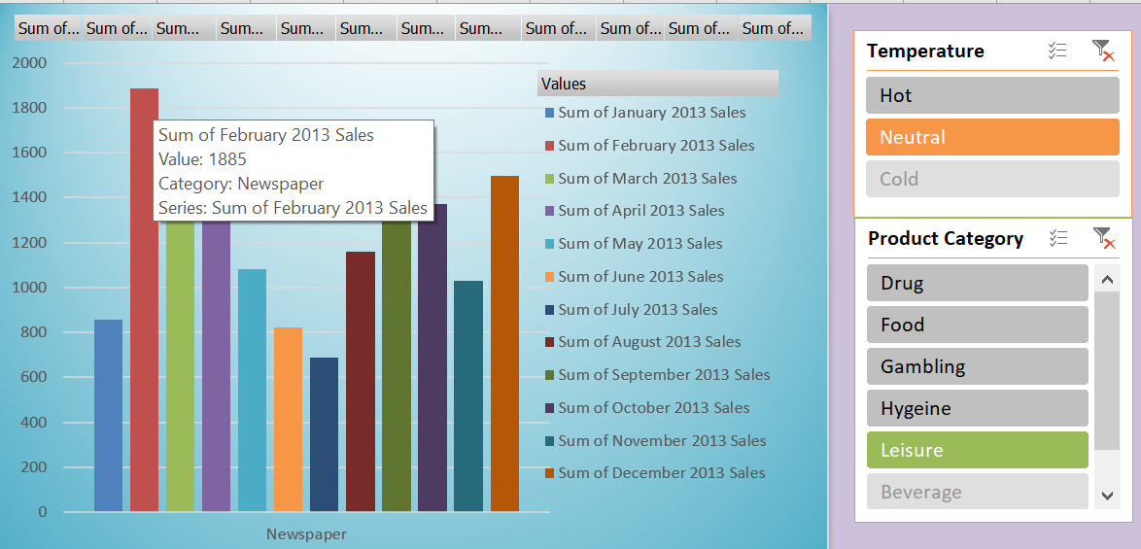
The highest sale in Leisure category and neutral temperature is Newspaper in the month February 2013.

Slide 12
THANK YOU

